Slide 1




Update on ATT&CK and CAR
EU ATT&CK Community Workshop
Approved for public release. Distribution unlimited 19-00066-7.

Slide 2
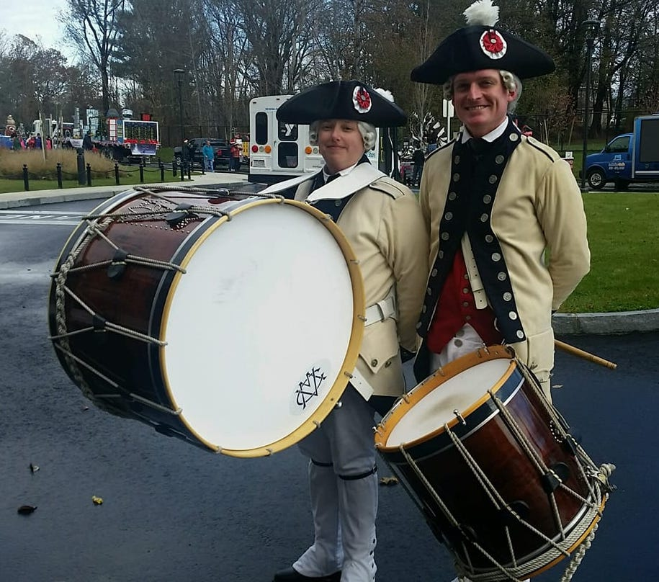
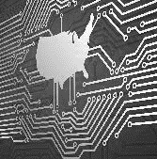

System Owner/User Discovery (T1033)
Senior Cyber Security Engineer
ATT&CK Infrastructure Lead
Analytics Researcher
John Smith
Lead Engineer
Drummer, apparently George Washington (?)
Jen Burns
Approved for public release. Distribution unlimited 19-00066-7.

Slide 3
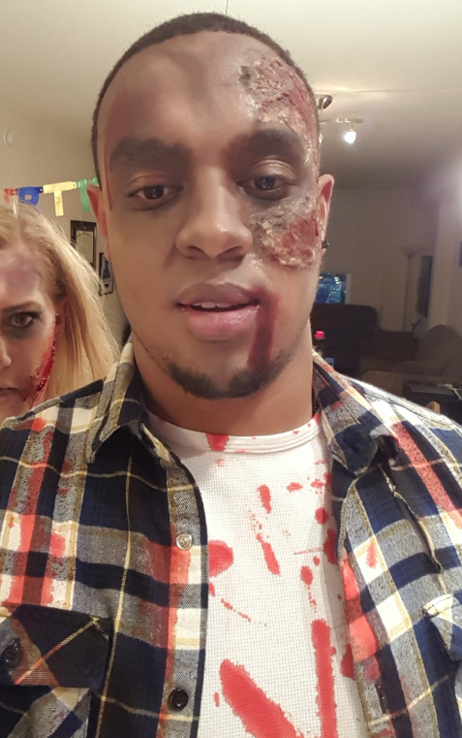

System Owner/User Discovery (T1033)
Lead Cyber Adversarial Engineer
ATT&CK Technique Dev. ATT&CK Evals Red Team
Adversary Emulation Researcher
John Smith
Lead Engineer
Zombie (?)
Jamie Williams
Approved for public release. Distribution unlimited 19-00066-7.

Slide 4
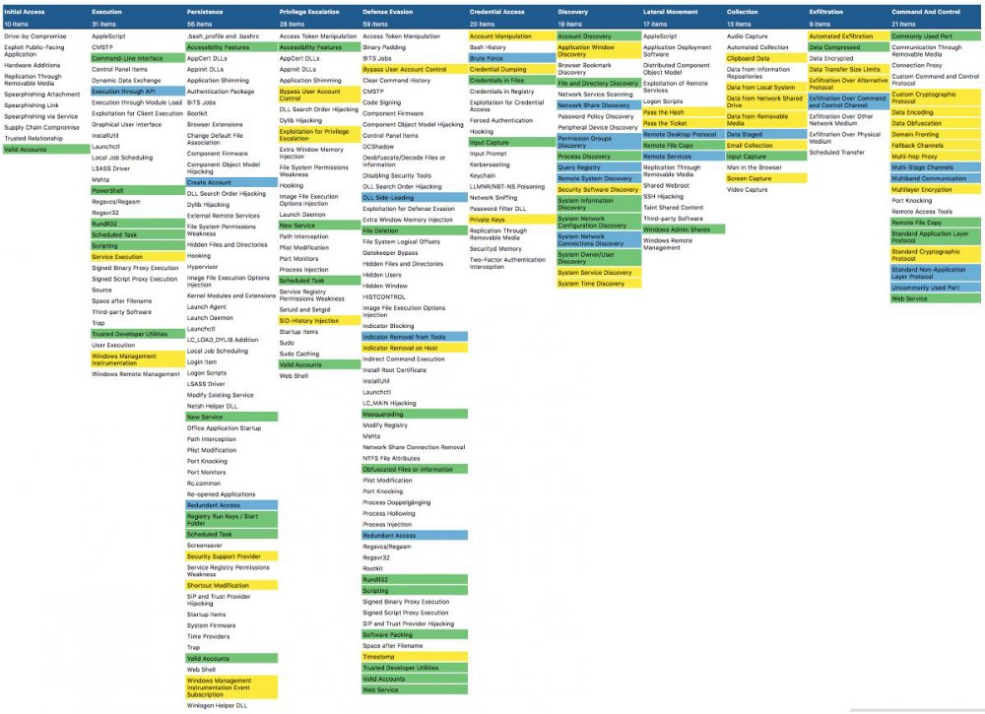

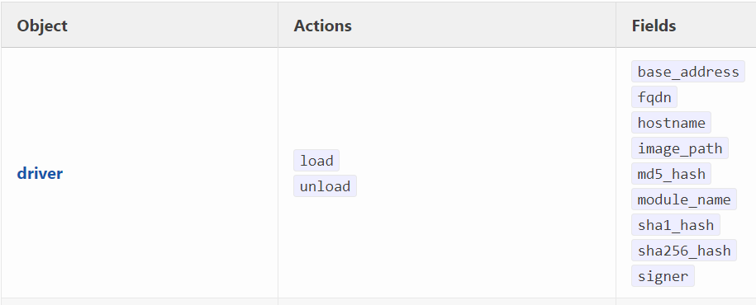
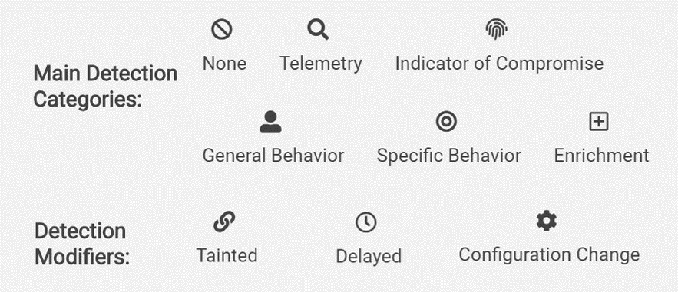
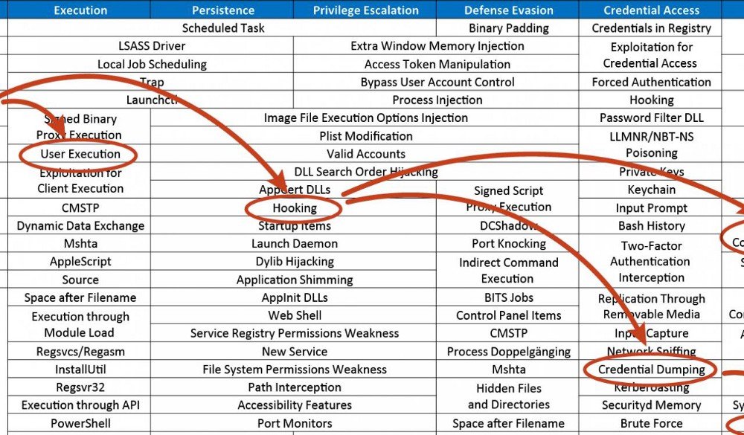

Slide 5
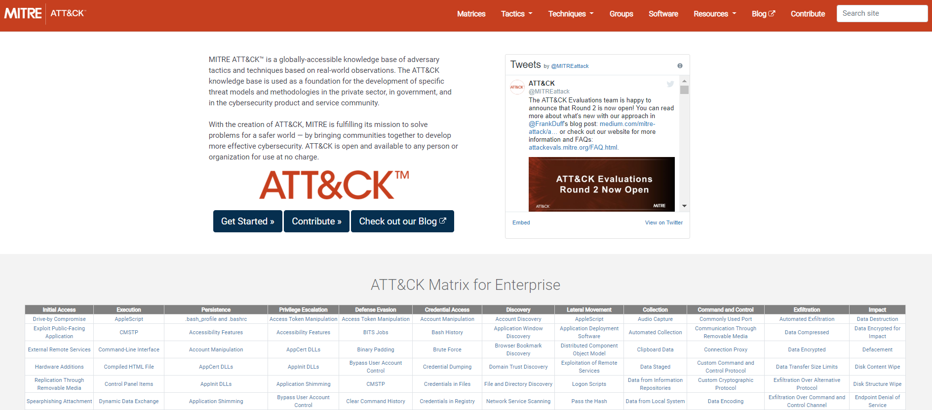
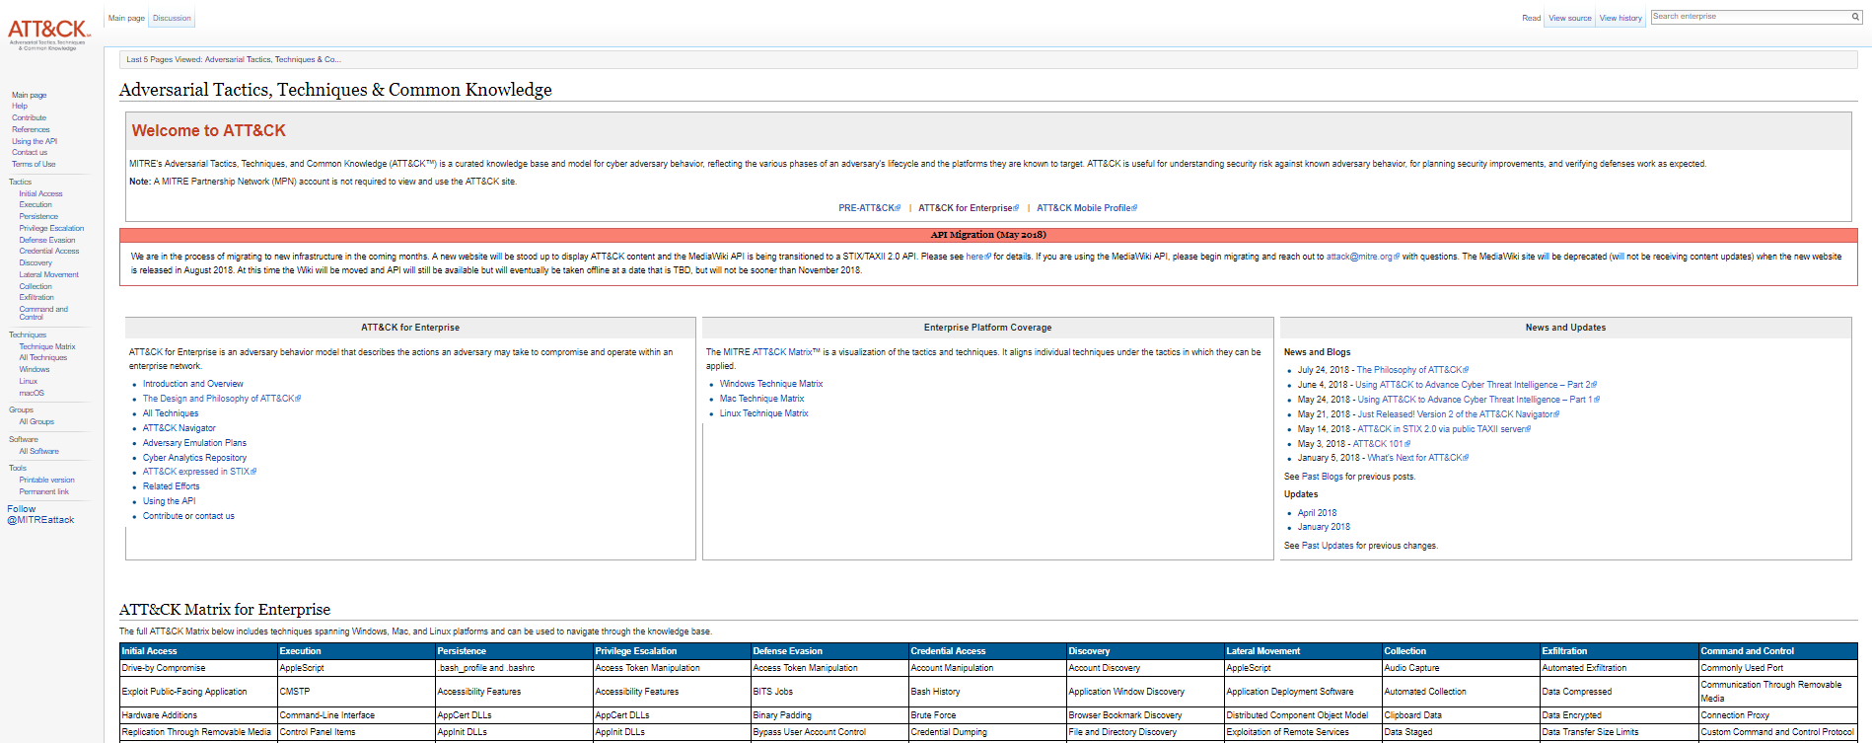
Website Redesign

Slide 6
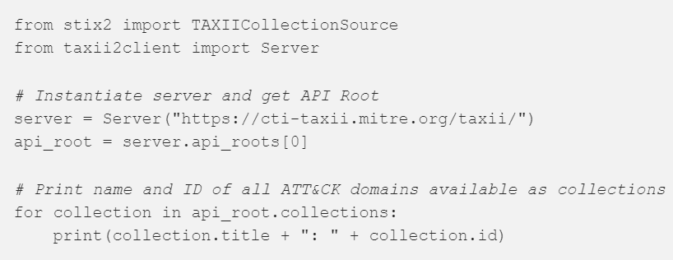
Making ATT&CK Easier to Use
Serving all content via TAXII 2.0 server
Also released content as STIX 2.0 via GitHub
Libraries and tools to work with ATT&CK content
cti-python-stix2 and cti-taxii-client

Slide 7
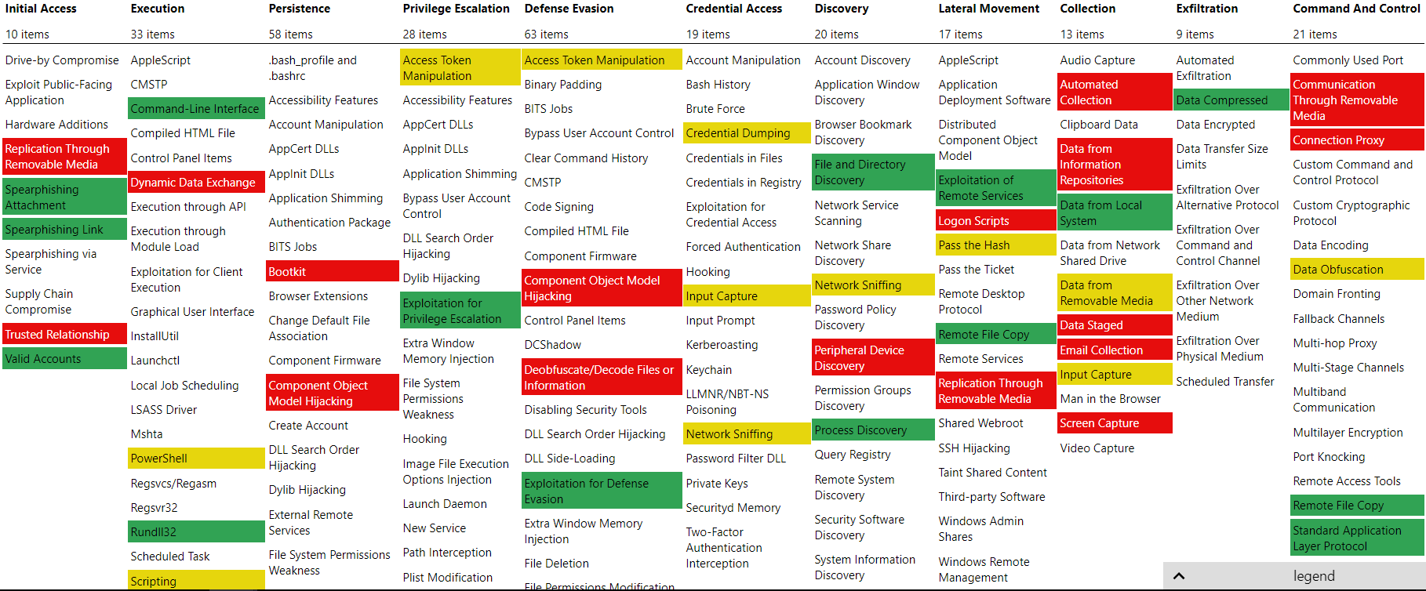
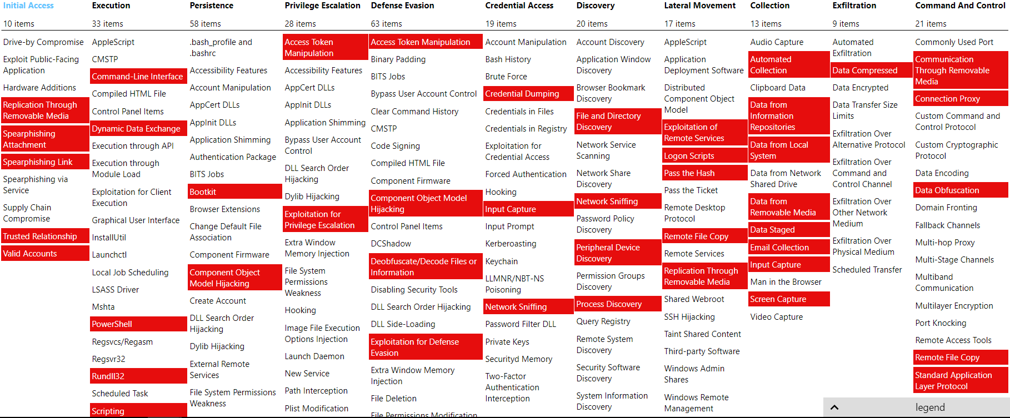
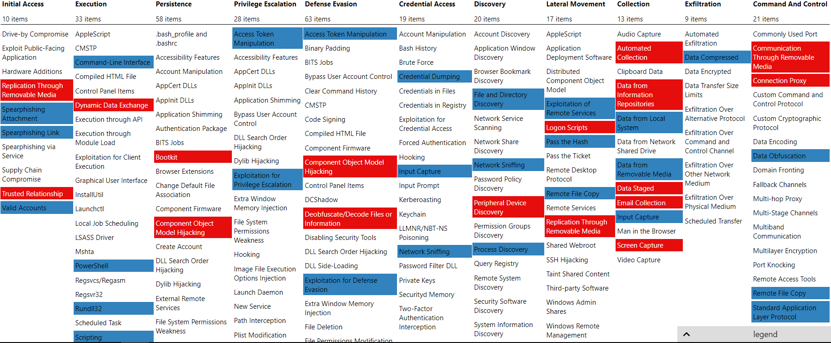
ATT&CK Navigator
mitre-attack.github.io/attack-navigator
mitre-attack.github.io/attack-navigator

Slide 8
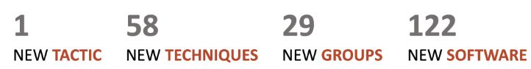
2018 Content Updates
~70% from the community

Slide 9
2019 Content Updates
April 2019 Release
New: 21 Techniques, 8 Groups, 50 Software
Impact Tactic
Updates: 22 Techniques, 31 Groups, 46 Software

Slide 10
Impacts Tactic
Attacks targeting availability and integrity
Ex: ransomware, DoS, destruction
14 Techniques
Data Destruction
Endpoint DoS
Resource Hijacking
Runtime Data Manipulation
Data Encrypted for Impact
Network DoS
Service Stop
Stored Data Manipulation
Disk Content Wipe
Firmware Corruption
Defacement
Transmitted Data Manipulation
Disk Structure Wipe
Inhibit System Recovery

Slide 11
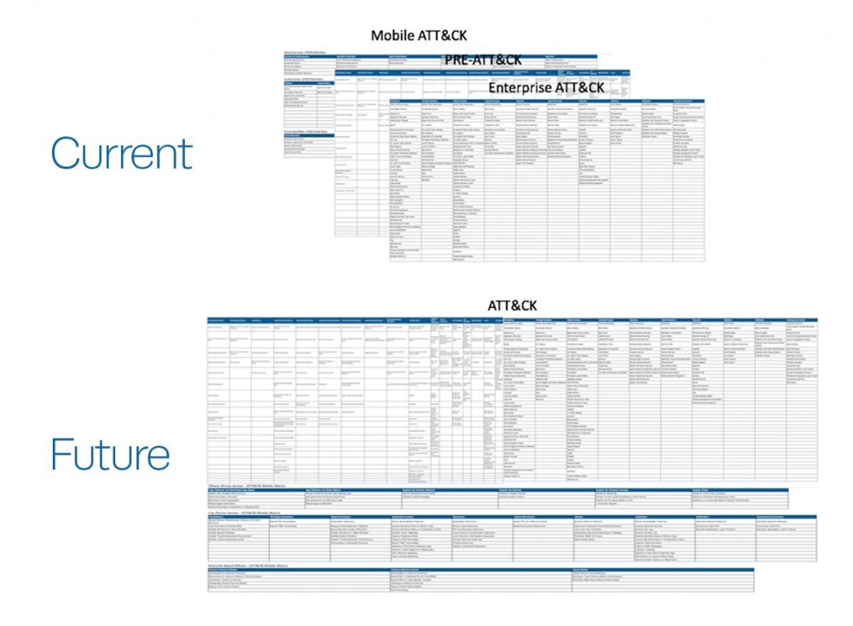
2019 Content Updates
Consistency and integration between matrices

Slide 12
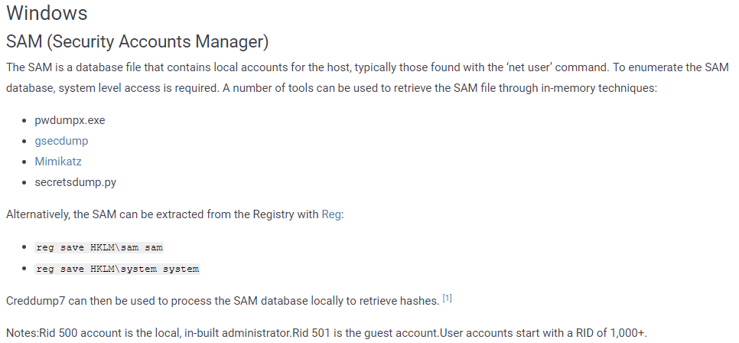
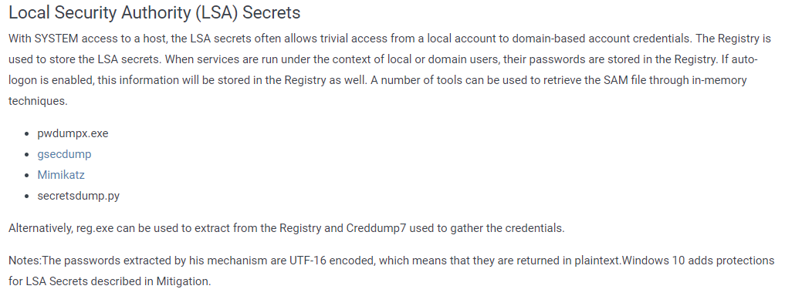
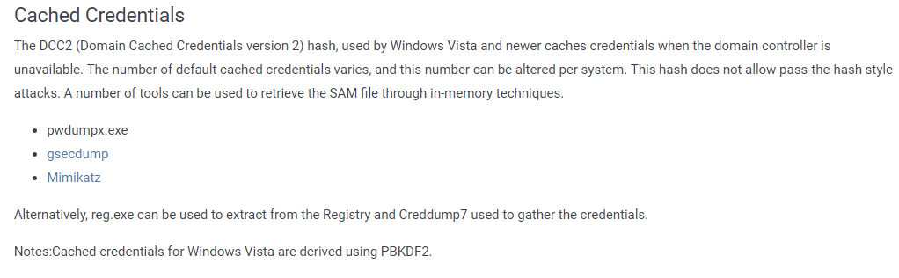
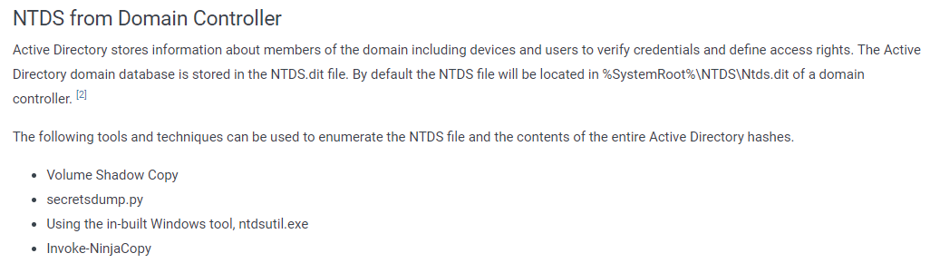
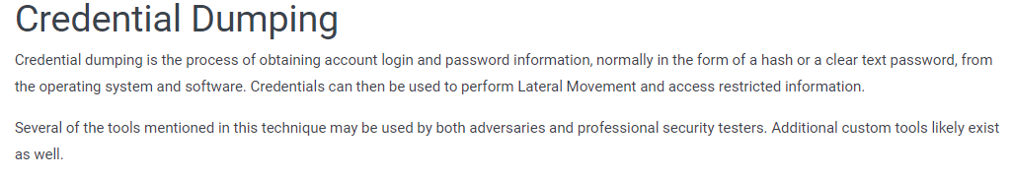
Sub-Techniques
Better define variations of Technique Procedures
Address differing levels of abstraction

Slide 13
ATT&CK Evaluations
Open and transparent methodology based on real-world adversary behaviors found in ATT&CK
No scoring or ranking
Goals:
Display vendor detection capabilities based on ATT&CK techniques
Bring transparency to evaluations
Empower end-users with objective insights
Drive the security community to improve capabilities

Slide 14
Round 1 - APT3/GOTHIC PANDA
Test methodology and the results available at
attackevals.mitre.org

Slide 15
ATT&CK Evaluations Round 2
Beginning Summer 2019
Based on APT29/COZY BEAR/The Dukes
More sophisticated technique implementations
Custom malware and alternate execution methods
Recently-closed public call for threat intelligence
Improved approach
attackevals@mitre.org

Slide 16
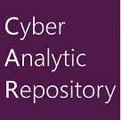
CAR Relaunch
Knowledge base of analytics developed by MITRE based on ATT&CK
Address barriers to sharing
Too hard to contribute
Didn’t know there was a place to do it
Didn’t know how, or tried and the process was too long
Don’t see the value
Don’t want to expose information

Slide 17

Make Sharing Easy with CAR
Make it easy to contribute
Pull requests
Make it easy to use
Standard open-source licensing

Slide 18
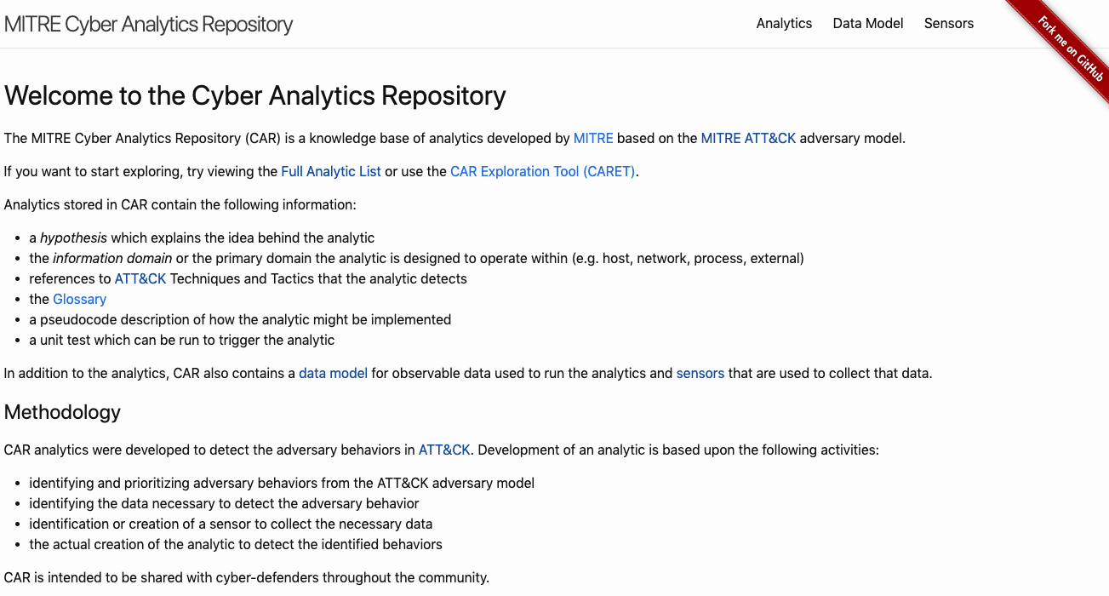
car.mitre.org – GitHub Pages

Slide 19
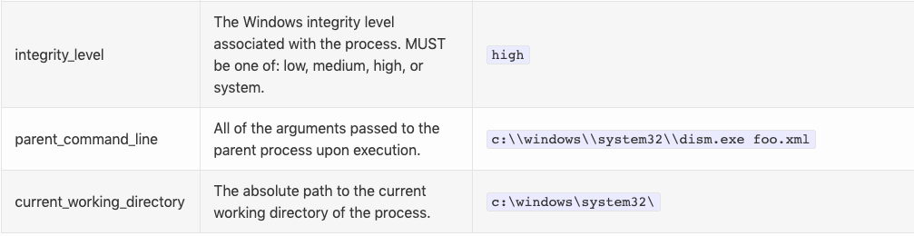
Updated Process Data Model
Catch up to expanded coverage of processes from Sysmon/other EDRs

Slide 20
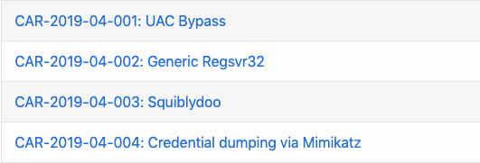
New Analytics!!
All vetted internally at MITRE

Slide 21
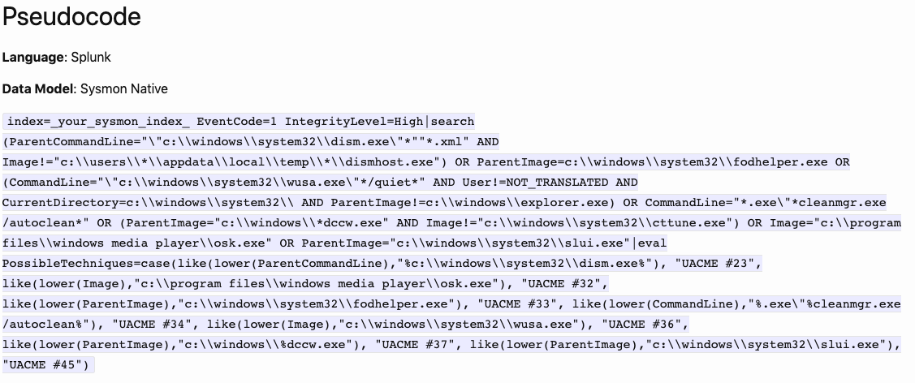
Native Splunk Queries

Slide 22
What’s Next for CAR?
Store analytics in JSON
Automation
Use and share analytics natively in tools like Unfetter, MISP, SIEMs
Hope to collaborate with Sigma
stix-shifter
Improved development
Test against real attacks
Prioritize development using real sightings data

Slide 23
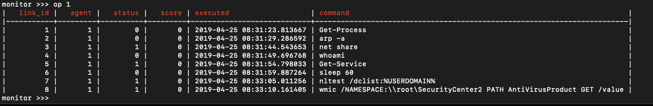
CALDERA Update
Automated adversary emulation system
Python 3.5.3+ dependency
New planning modules
Plugins (Adversary, Chain, GUI, 54ndc47, Stockpile)
github.com/mitre/caldera

Slide 24
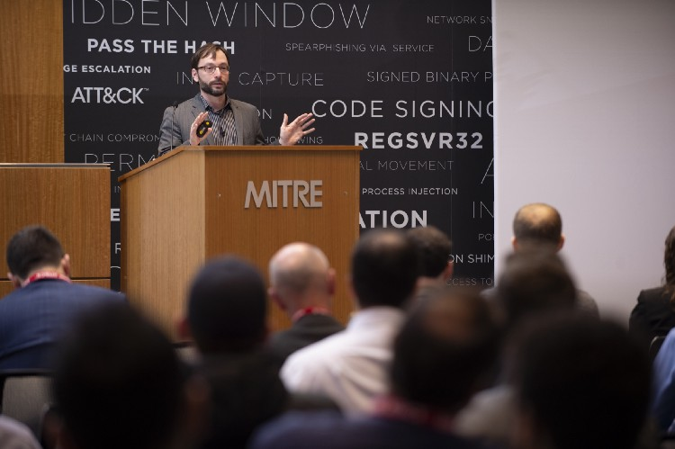
Inaugural ATT&CKcon
Videos and slides available online
attack.mitre.org/resources/attackcon/
“If you want to go fast, go alone. If you want to go far, go together.”
Keynote from John Lambert of Microsoft’s Threat Intelligence Center

Slide 25
ATT&CKcon 2019
Call for papers will be open from May 15 - June 15
Registration will open in mid-August
Event is October 28-30 @ MITRE McLean Campus, Virginia
Will provide live coverage of all presentations

Slide 26
Thanks To You
Sightings / Contributions
Community Adoption
Feedback and Support

Slide 27


attack.mitre.org
medium.com/mitre-attack
attack@mitre.org
@MITREattack

